Slide 1

Rikiddo
一种流动性敏感的动态对数市场评分规则

Slide 2



目录
AGENDA
01 | Scoring Rule - 评分规则
02 | Market Scoring Rule - 市场评分规则
03 | Logarithmic Market Scoring Rule
对数市场评分规则
04 | Liquidity-Sensitive Logarithmic Market Scoring Rule
流动性敏感对数市场评分规则
05 | Rikiddo
一种流动性敏感的动态对数市场评分规则

Slide 3

Scoring Rule
01
评分规则

Slide 4
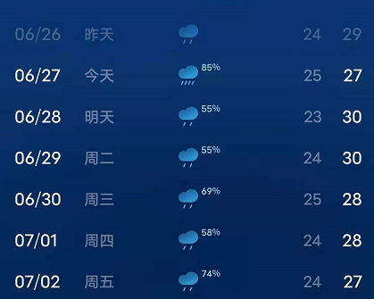
天气预报
评分规则是指在决策理论中衡量概率预测的准确性的一种方案
适用范围：必须将概率和一组互斥结果相对应的情况，其概率总和为1

Slide 5

评分规则原理
假设 Ω 是一组可能的结果，则对于该事件的概率预测就是 Ω 的概率分布
评分规则 S 是一个以在 Ω 上的概率分布 P 和一个结果 ω∈Ω 为输入的函数
$S(P,ω)$代表的就是对于预测者的奖励 / 惩罚。

Slide 6

对于分类变量（离散）
对于连续变量
Brier Score
Spherical Score（球形分数）
Logarithmic Score（对数分数）
Zero-one Score（0-1分数）
Quadratic Score
（二次分数）
Pseudospherical Score（伪球形分数）
Logarithmic Score
（对数分数）
Score Rules

Slide 7
Market Scoring Rule
02
市场评分规则

Slide 8
Logarithmic Market Scoring Rule
03
对数市场评分规则

Slide 9
Liquidity-Sensitive Logarithmic Market Scoring Rule
04
流动性敏感的对数市场评分规则

Slide 10
Rikiddo
05
一种流动性敏感的动态对数市场评分规则

Slide 11


Slide 13
References
Scoring Rules and Peer Prediction
Market Scoring Rules
An Axiomatic Study of Scoring Rule Markets
Proper Scoring Rules and Prediction Markets

Slide 14

Zeitgeist is an evolving blockchain for prediction markets and futarchy
Built on Substrate, Ready for Polkadot
The most common prediction market trades only two outcomes on an event: “Yes” or “No”. This means that traders are betting on whether an event happens or it does not. These markets are sometimes known as binary markets since they only trade two distinct outcomes.

